Slide 1
Practice, Praxis, Place:
Locating educational development in the scholarship of learning and teaching
Keith Smyth
Professor of Pedagogy
University of the Highlands and Islands
#sedaconf @smythkrs

Slide 2

Broad themes to explore
What is the scholarship of educational development?
Where is the scholarship of educational development?
How do we evidence impact of educational development?
Emerging dimensions in our digital practice
educational development as activism
So who is the educational developer?

Slide 3
Two framing propositions
If HE is a public good, then educational development must offer a collective means to challenge practice in our institutions and the sector
Educational development is under increased scrutiny within our institutions, and we need to diversify as well as evidence our practices

Slide 4
Scholarship of learning and teaching
Scholarship of educational development

Slide 5
Scholarship of learning and teaching
“problem posing about an issue of teaching or learning, study of the problem through methods appropriate to the disciplinary epistemologies, applications of results to practice, communication of results, self-reflection, and peer review”
Cambridge, B. (2001) Fostering the Scholarship of Teaching and Learning: Communities of Practice. To Improve the Academy: A journal of educational development. Vol 19. pp. 3-16

Slide 6
Scholarship of educational development
“Articulating what we contribute to higher education teaching and learning communities, including what evidence informs our work and what evidence we have of the impact of our work…engage systematically with the complex problems and opportunities we face in higher education”
Little, D. (2014) Reflections on the state of the scholarship of educational development. To Improve the Academy: A journal of educational development, Vol 33(1), pp. 1–13.

Slide 7
Where is the scholarship
of educational development located?

Slide 8
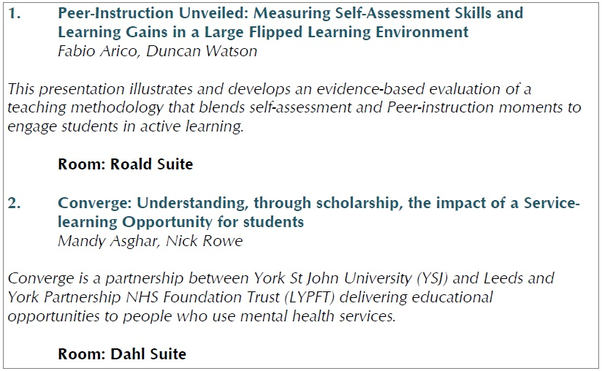
Pedagogic practice

Slide 9
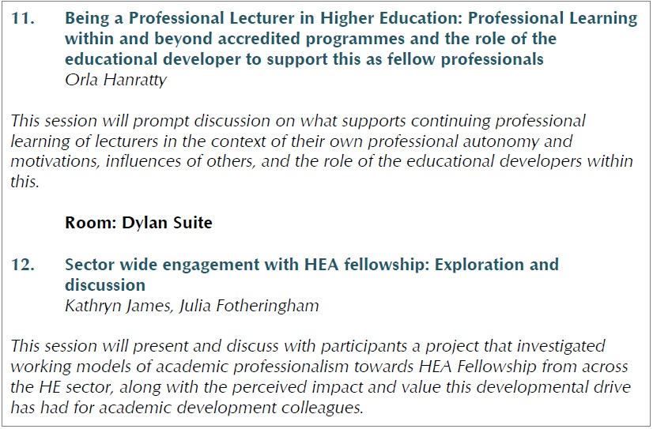
Programmes and frameworks

Slide 10
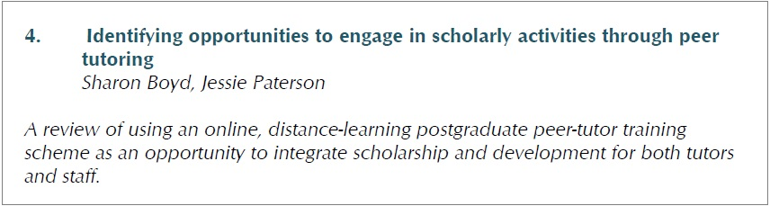
The scholarship of those we support

Slide 11
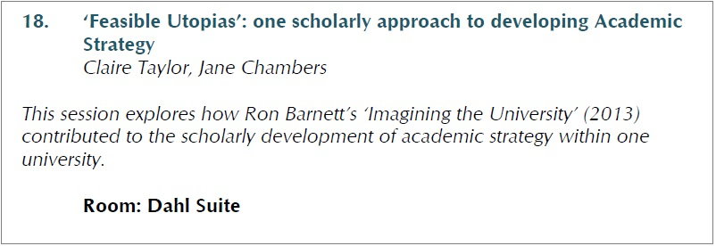
Strategy and policy

Slide 12
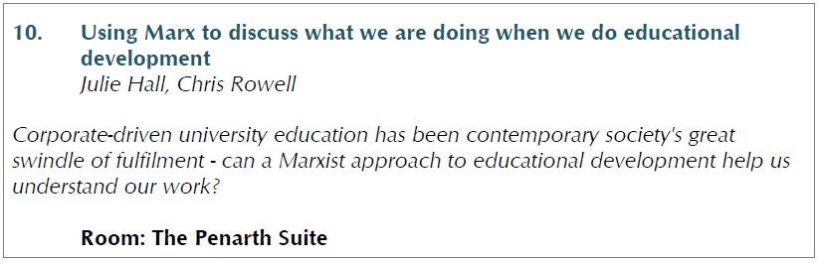
Criticality

Slide 13
Evidencing the impact
of educational development

Slide 14

Beyond the curried cheese sandwich
(a personal epiphany)

Slide 15
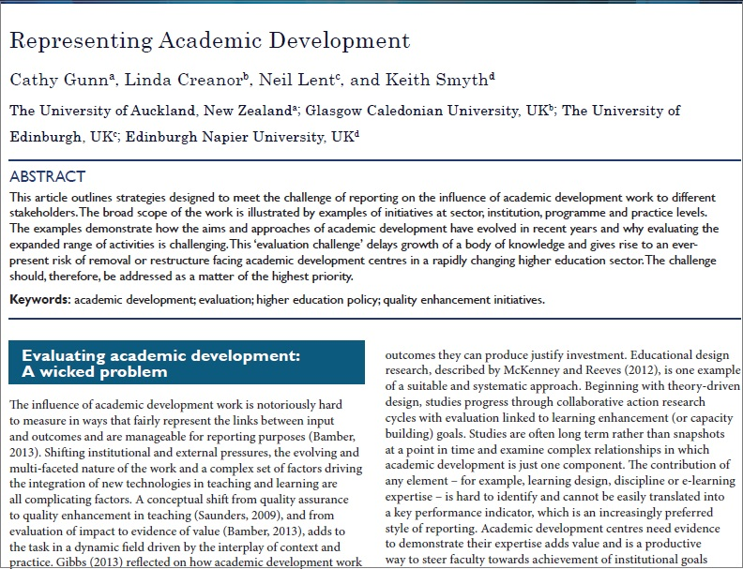
A wicked problem

Slide 16
From
How was it for you?
Enhancing practice
Using ideas of others
Unsure of our strengths
Knowing own context
Working within *
To
What does it mean for you?
Broadening perspectives
Creating ideas of our own
Working beyond our limits
Situating our practice
Working to improve *
[*curriculum/department/institution/field/sector]

Slide 17

Quiet moments of encouragement
for me, aka ‘John Cowan’ moments

Slide 18

‘Guerrilla’ educational development
Enhance your practice. Now!
Image source: flickr. “Cartoon angry army drill sergeant shouting” (c) 2011 KoiQuestion

Slide 19
Solving a wicked problem?
Set targets with quantifiable and ‘soft’ measures in evaluation
Identify the audience for evaluation findings and tailor the
data gathering, analysis and reports accordingly
Offer case studies to illustrate critical influences and impact
Highlight role of collaboration, networking and partnership across all levels within and beyond the institutional context
Identify follow-up actions to enhance strategy, research and practice and build further evidence of value and impact

Slide 20

Protecting what we do

Slide 21
Dimensions in digital practice

Slide 22
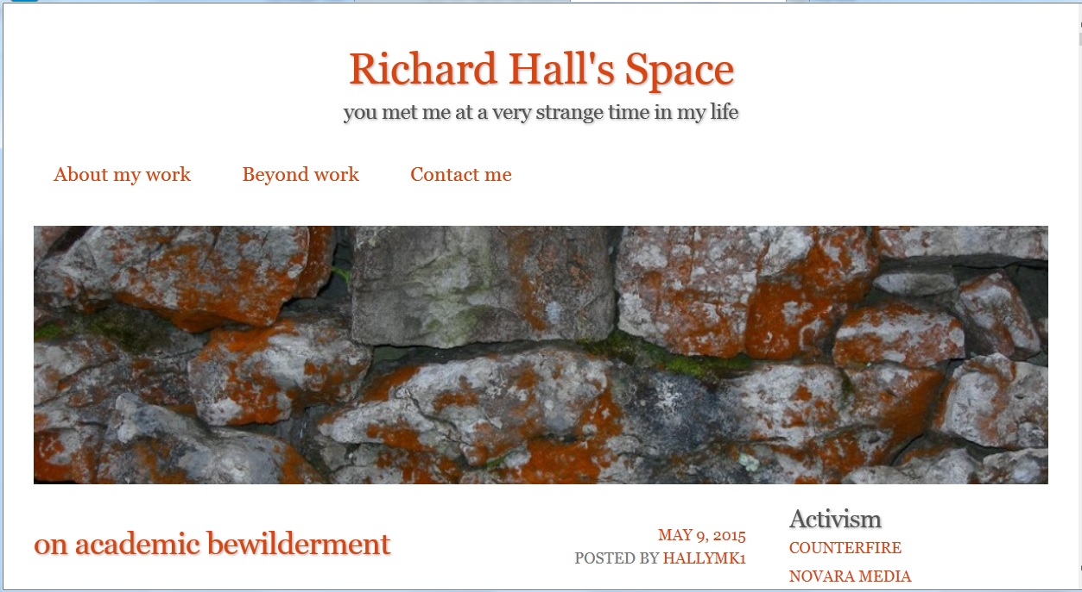
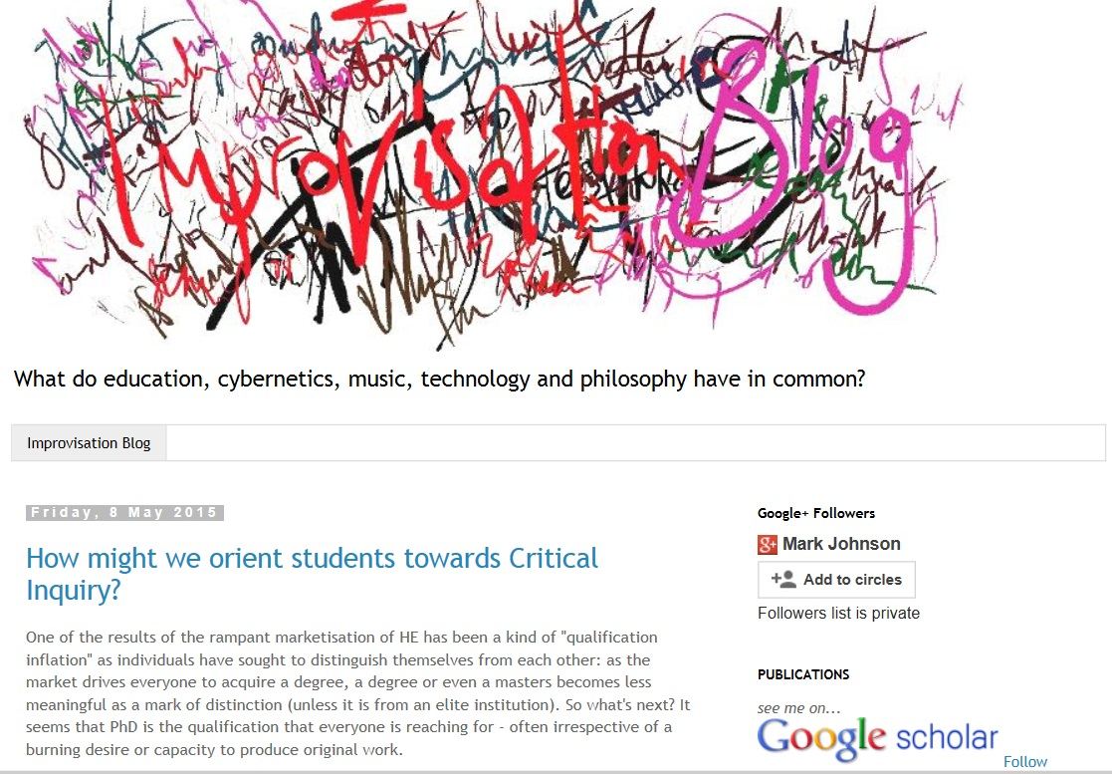
‘Surfacing’ and sharing critical views
http://www.richard-hall.org/
http://dailyimprovisation.blogspot.co.uk/
Notes:
Richard Hall. Mark Johnson. Richard’s latest post on ‘Academic Bewilderment’…

Slide 23

Shaping and sharing good practice

Slide 24






Locating ourselves in digital networks

Slide 25
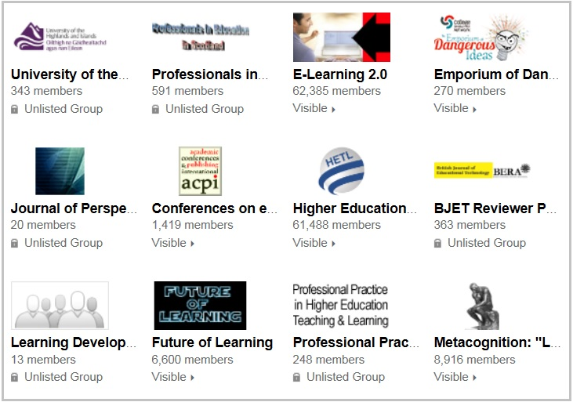
Some of my groups and communities

Slide 26

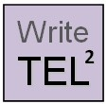
Online engagement in educational scholarship

Slide 27
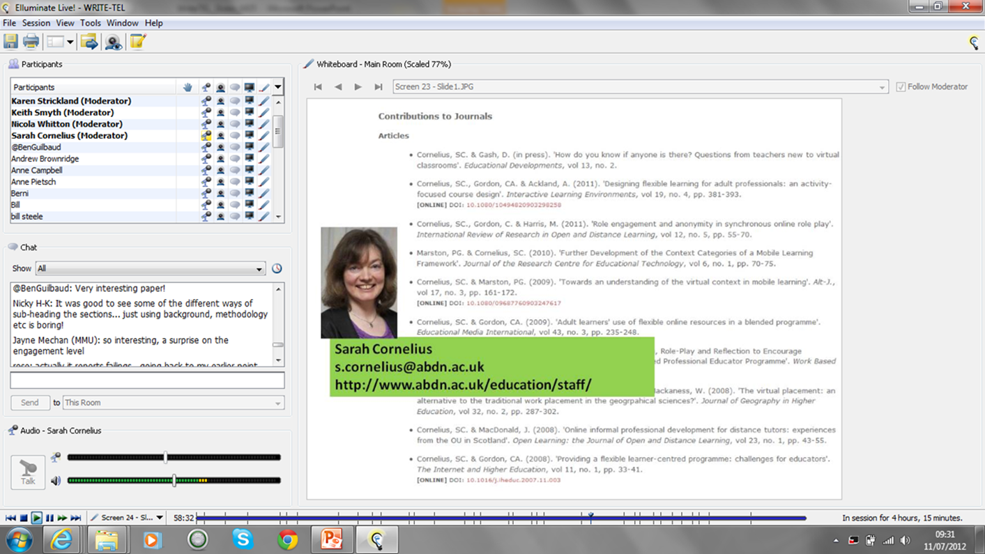

Slide 28

Supportive open scholarship

Slide 29
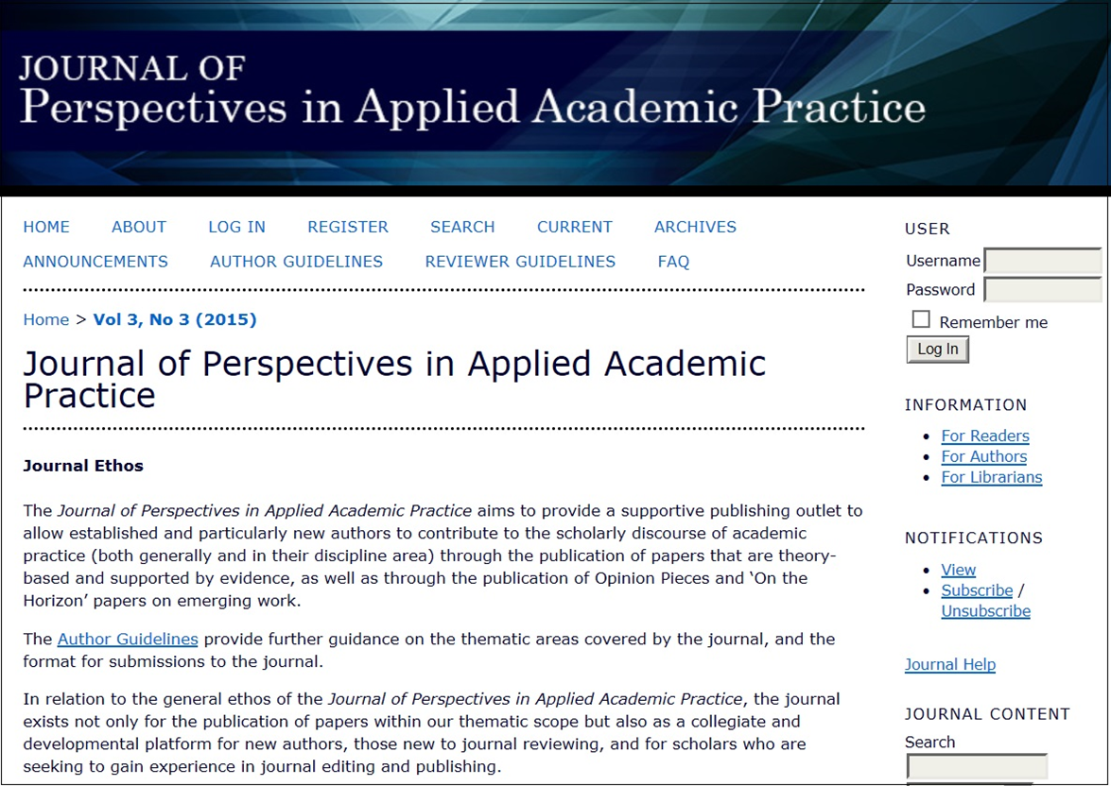
Demystifying and deconstructing

Slide 30
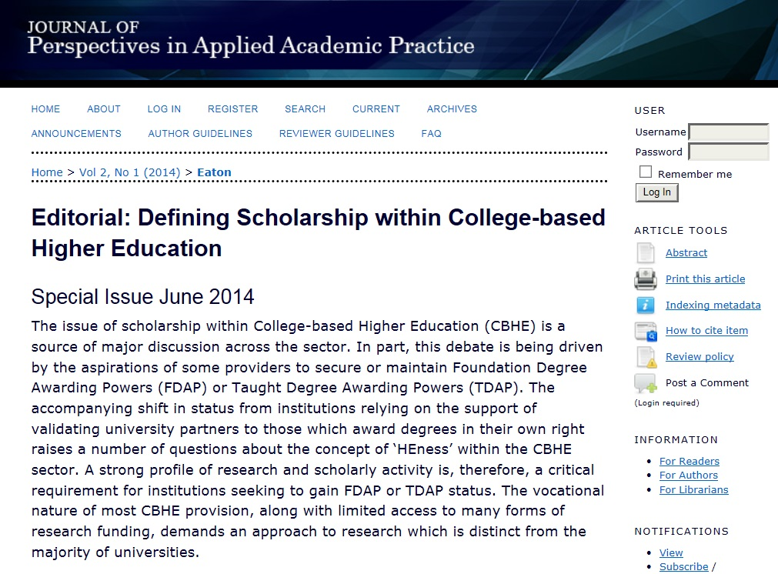

Slide 31
Educational development as activism

Slide 32
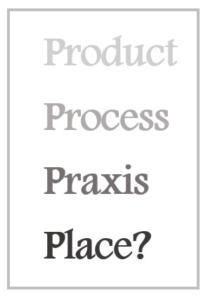

Slide 33
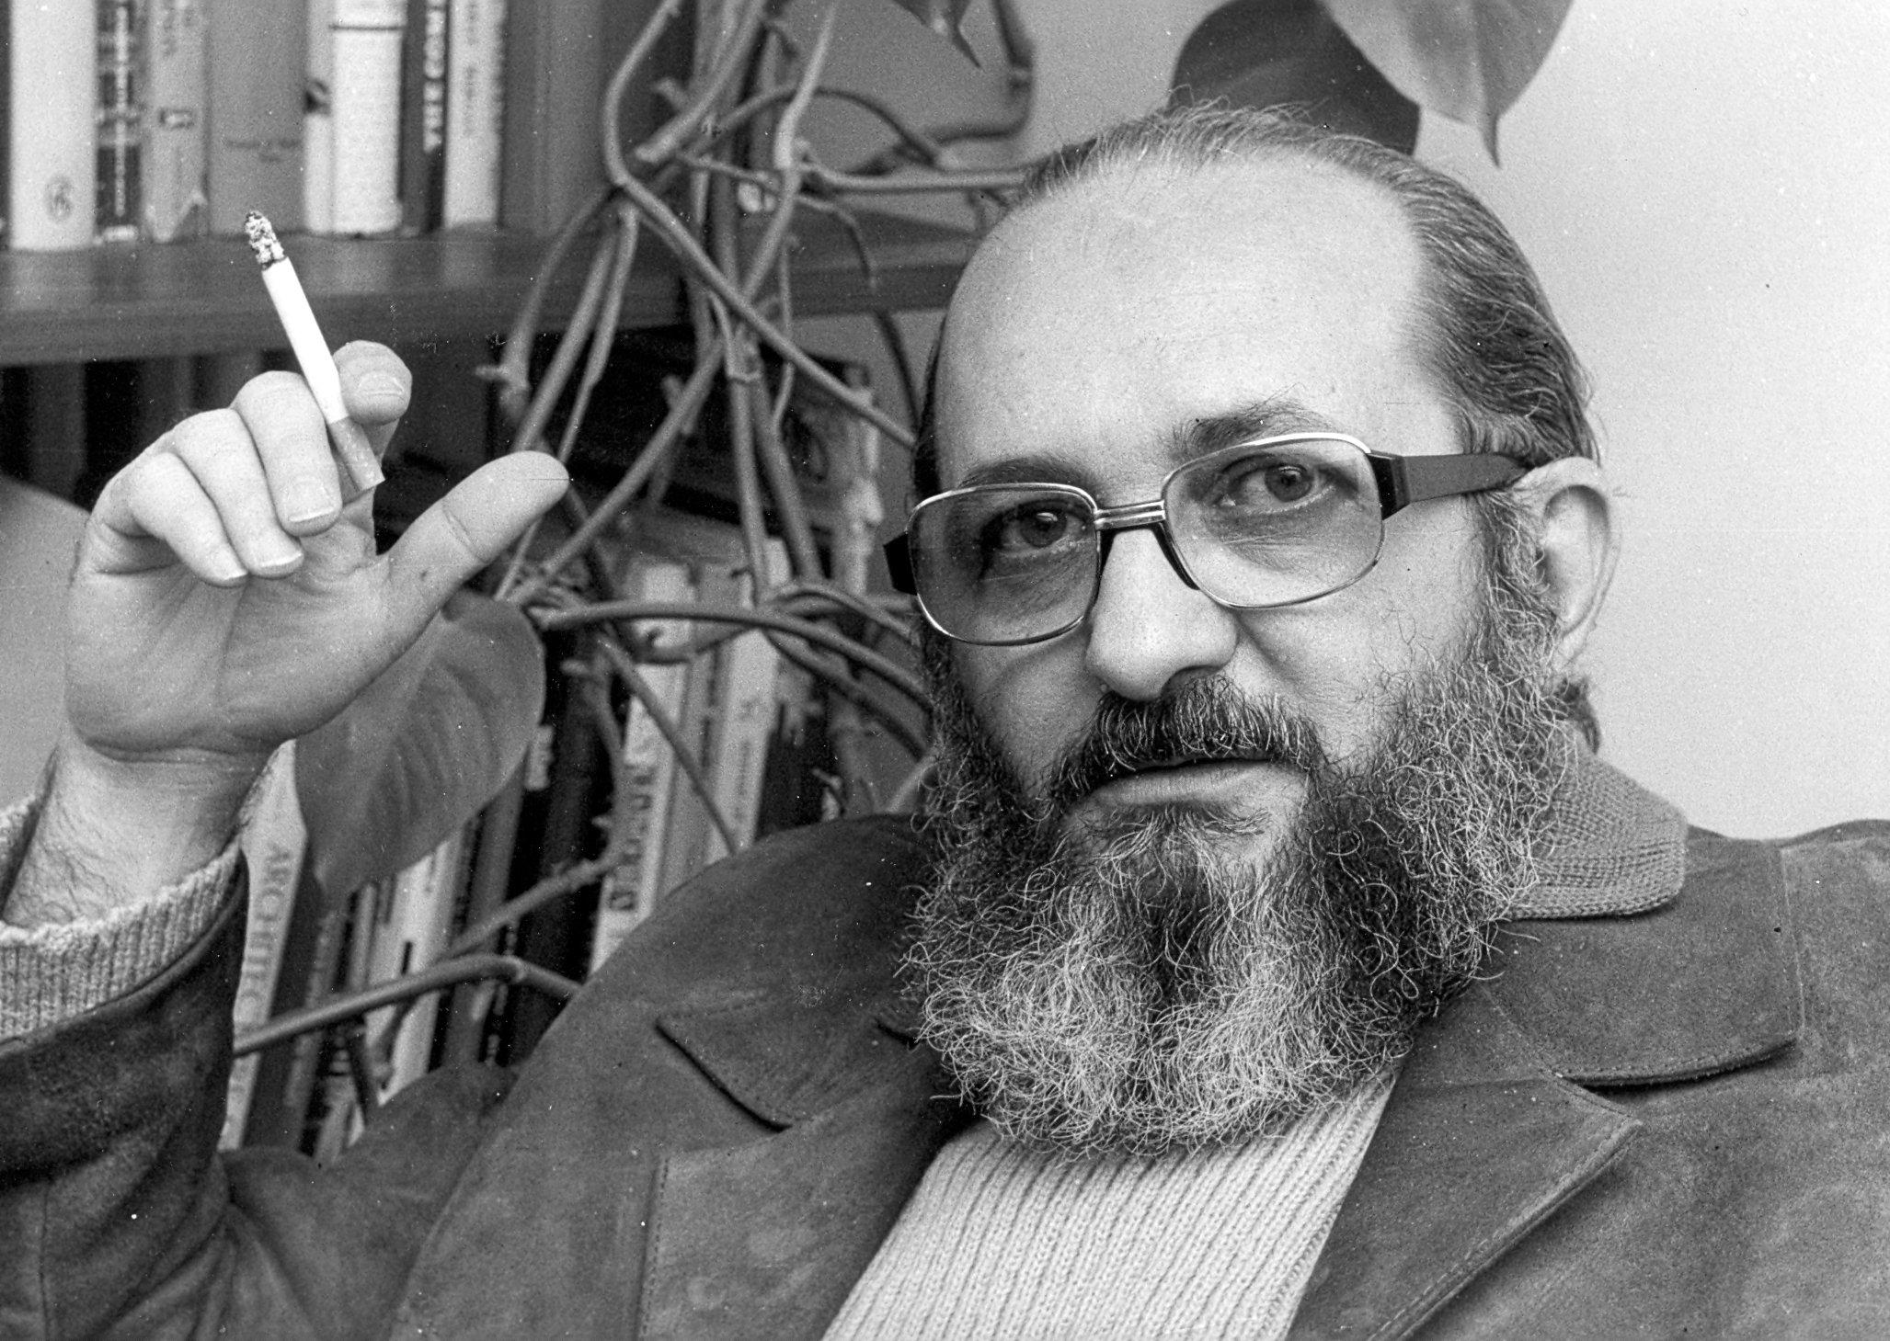
Praxis
“reflection and action directed at the structures to be transformed”.

Slide 34
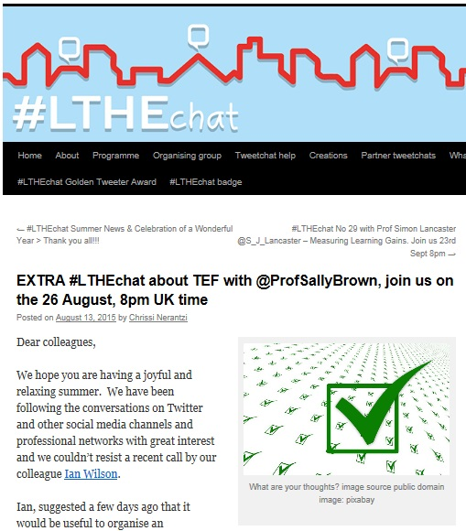
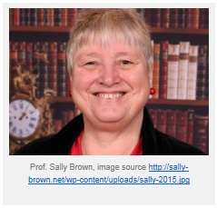
Connecting and amplifying our voice

Slide 35
Challenging ‘The Academy’?
TEF

Slide 36
Who is the educational developer?

Slide 37
Critical friend
Critical pedagogue
Facilitator of effective practice
Scholar and curator
Leader and policy maker
Activist

Slide 38
Which of these positions do you occupy coming into today, and which will you move into during and beyond the conference?

